Slide 1
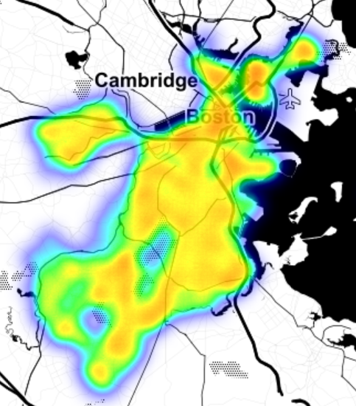
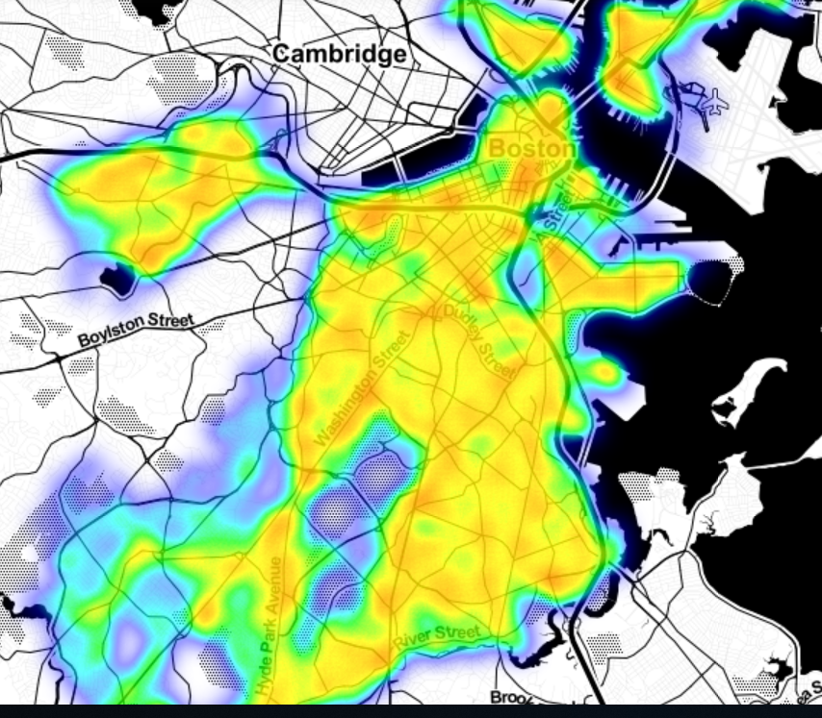

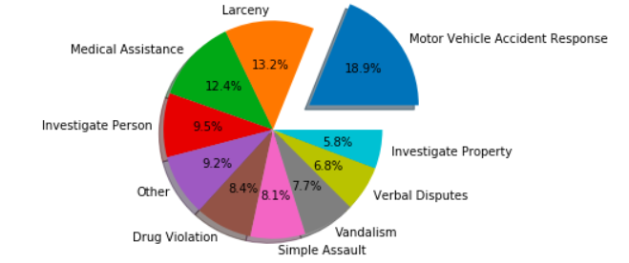



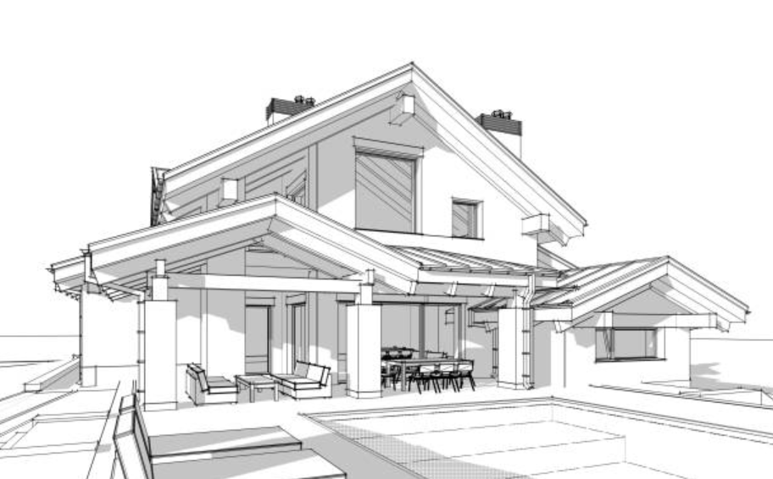


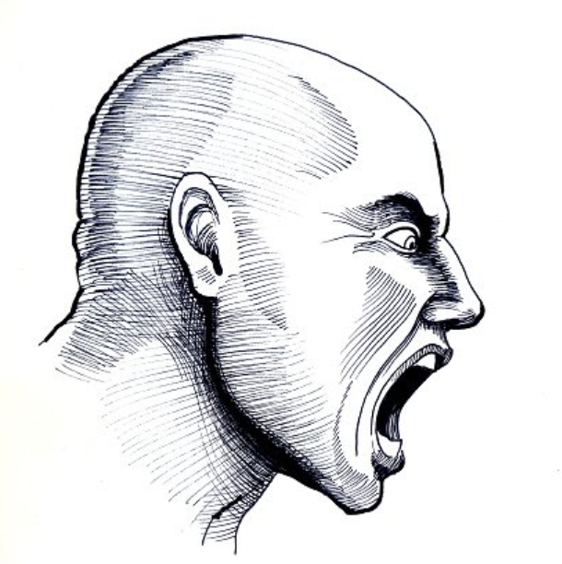


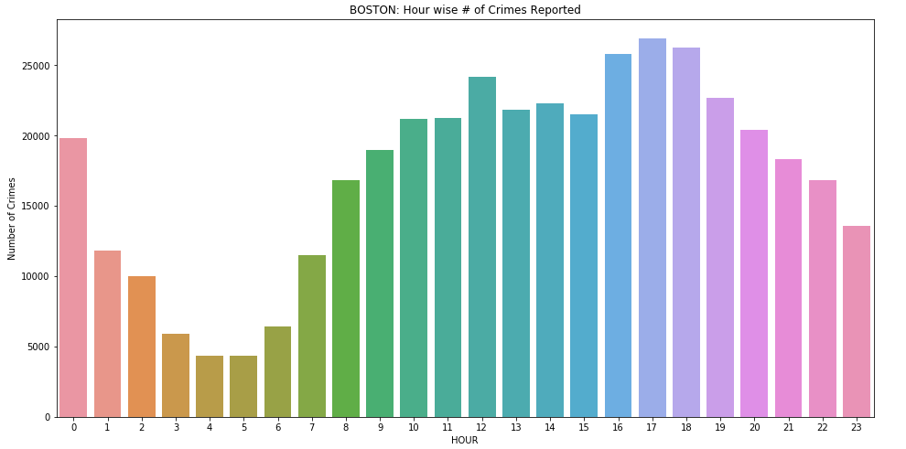
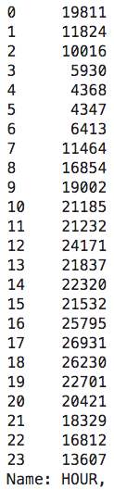
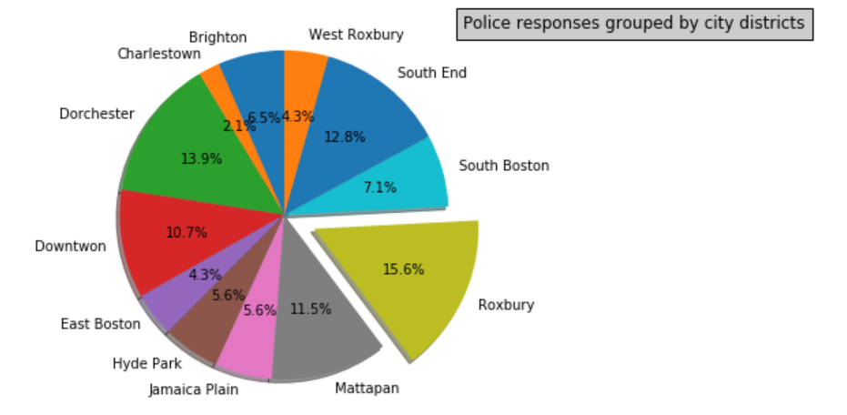
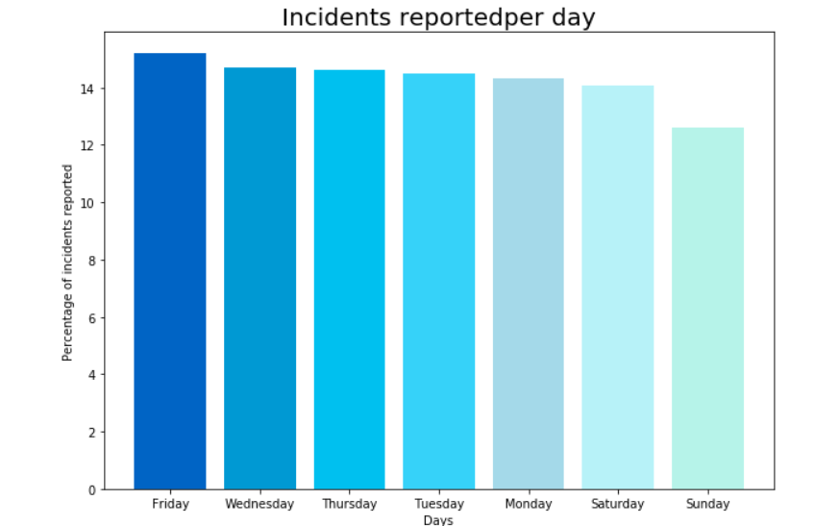
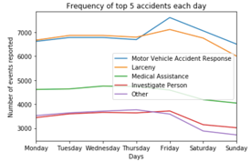
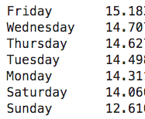
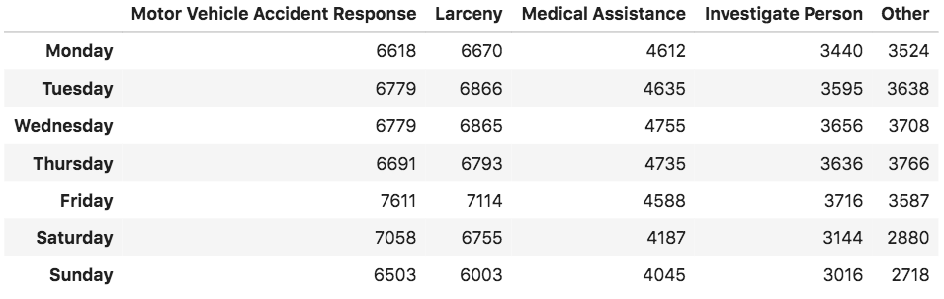
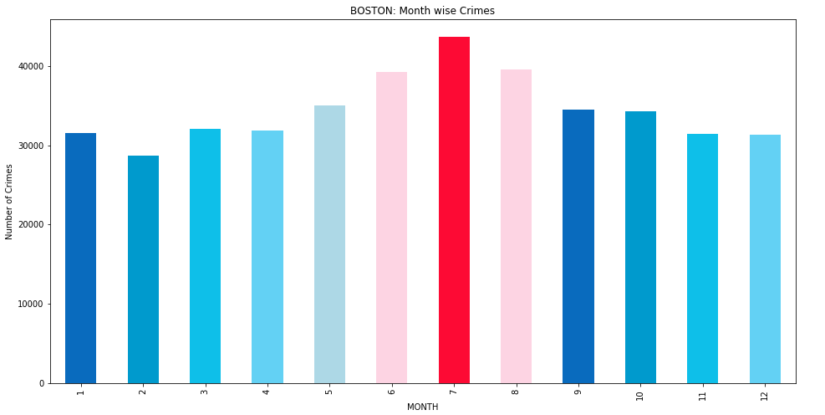
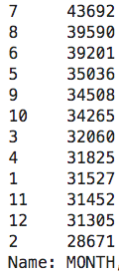
Boston Police Department Case Study
(2015-2019)
Data : https://www.kaggle.com/AnalyzeBoston/crimes-in-boston
License : CC0: Public Domain
Adam Julius Olof Kviman, Anja Stene ,Mathias Bergane Johansen , Meera Joseph
Visualization to analyze the reported incidents trends in Boston over mid 2015 to mid 2019 is represented on the poster . Analysis was carried out using python and libraries like matplotlib , pandas, seaborn, NumPy and folium.
10 most common incidents reported (2015-2019)
Heat map of incident distribution(2016-2017)
The pie chart represents percentage of the 10 most frequently reported incidents in Boston in 2015-2019. Motor Vehicle accident tops the list with almost 18.9% of the total proportion.
The heat map represents the frequency of responses happening in different streets of Boston in 2016-2017.
The frequency of crimes in different areas are represented by colors ranging from red (representing the highest frequency of reports) to blue (representing the lowest frequency of reports)
Incident frequency per hour (2015-2019)
Crime Distribution based on city districts
The bar chart represents incidents reported in Boston every hour during 2015-2019. Most case were reported from 16:00 hrs to 18:00 hrs with a peak at 17:00 hrs
The pie chart represents the crime distribution in various city districts
of Boston . Roxbury tops the list with 15.6% of reporting.
Source: Wikimedia Commons
Attribution: Goran tek-en [CC BY-SA 4.0 (https://creativecommons.org/licenses/by-sa/4.0)]
Specific crime trends:Top 5 Reported incident frequency per day(2015-2019)
Incident frequency variation over days (2015-2019)
We examine the crime trends of the top 5 most commonly reported incidents (Motor vehicle accident response, Larceny, Medical assistance, investigate person) over the days of a week. The following trends are observed:
Bar chart represents the distribution of police responses occurring each day in Boston during 2015-2019. Approximately 15% of the responses occur on Fridays.
Incident frequency variation over months (2015-2019)
From the analysis we could infer :
Case trends in Boston during (mid 2015- mid 2019)
The prime location of reporting's.
Change in frequency of cases over hours, days and months.
We examine the crime trends of the top 5 most commonly reported incidents(Motor vehicle accident response, Larceny, Medical assistance, investigate person) over days of a week.
This bar chart represents response frequency variation over the year. June has the highest number of responses.
Results and Inference
www.nmbu.no

